Slide 1
HP Supplies Media Carousel
Mariona Castelló
HP Global Supplies Marketing
February 8th
Notes:
Agency: Beeline / Design Kitchen who built the clones playbook for amazon
Playbook:
Compilation of best in class experiences/executions in Amazon
This is US experiences being explored
The EMEA ASINs “issue” would still be present
Vs Stefan’s playbook: SK’s Playbook is clones-specific for affected SKUs

Slide 2
Setting the stage
Background and current challenges
Business objectives
Online Shoppers more likely to look at images than to read long product descriptions.
Mixed and inconsistent assets showing up in a same product page.
Each country using their own choice of assets/designs for the media carousel
Amazon:
  Challenge: HP is allotted six image slots on the left nav bar in the product page. If HP does not populate all slots, third parties are populating with other compatible products, refurbs, remans, clones.
  EMEA Amazon content clean-up project: consistency among all assets appearing in the media carousel, crisp and appealing to trigger sales and preference for OHP.
Ensure HP premium online presence.
Present basic product content differently, appealing.
Protect current online positioning, ward off encroaching competition on HP real estate.
Promote strong HP Brand, imagery, value propositions, on partner stores and online sites – pursuing brand consistency among all digital touchpoints.
Increase engaging emotive presence for online supplies.
Increase OHP Preference. Grow customer conversion on product page
WW Supplies to own the Media Carousel assets
to ensure brand consistency among all online touchpoints

Slide 3
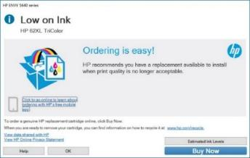
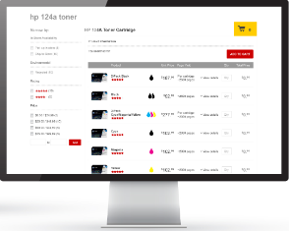
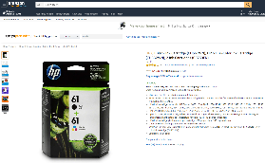

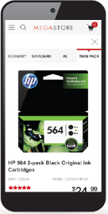
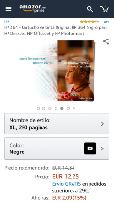


Customer journey up to
15 minutes
Low on ink alert or
Run out of ink
Research
Buy

Slide 4
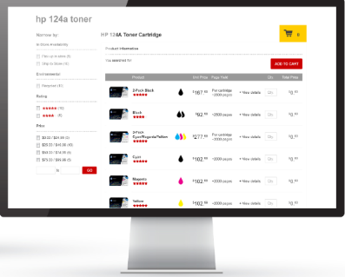
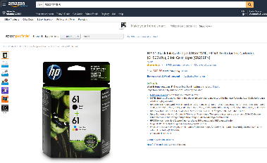
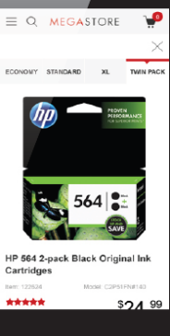



Supplies online customer has short attention span of
1-2 seconds
Succinct
Concise
Pithy
Simple
Easy to apprehend
Crisp
Straight to the point

Slide 5
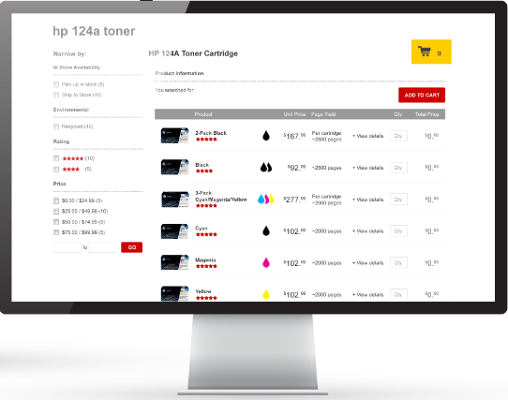

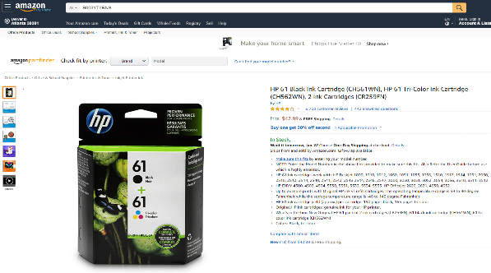
Supplies online customer prefers looking at
images
rather than reading long product descriptions
Catchy
Appealing
Simple
Relevant
Increase OHP preference
Straight to the point

Slide 6

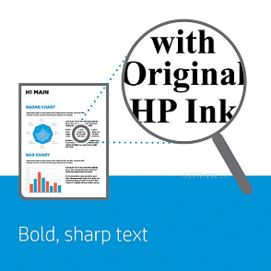
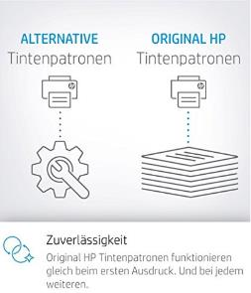


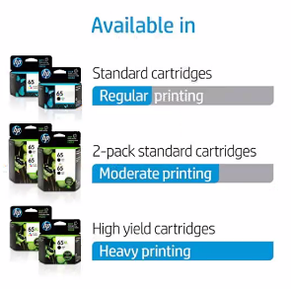





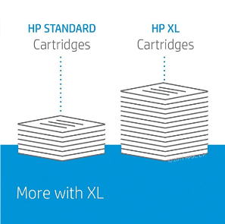
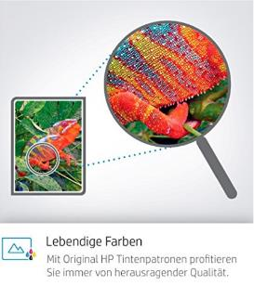
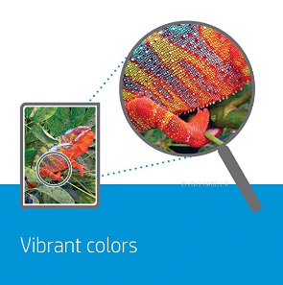
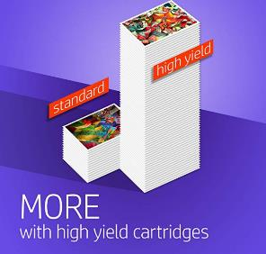
HP’s pain points

Slide 7
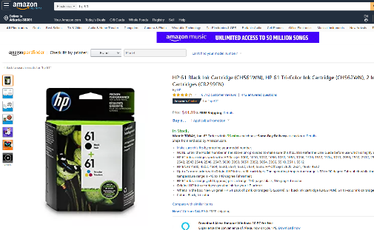
Inconsistent designs in same product page (Amazon US)
https://www.amazon.com/HP-Cartridge-Tri-Color-Cartridges-CR259FN/dp/B003YT6RNS/ref=sr_1_1?s=electronics&ie=UTF8&qid=1546956522&sr=1-1&keywords=hp+61

Slide 8
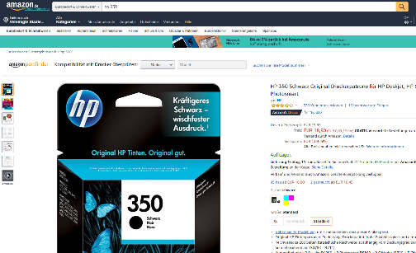


Locally-produced designs , copy heavy (Amazon DE)
https://www.amazon.de/HP-Original-Druckerpatrone-Officejet-Photosmart/dp/B000NOSAXW/ref=sr_1_4?ie=UTF8&qid=1546956995&sr=8-4&keywords=hp+350

Slide 9
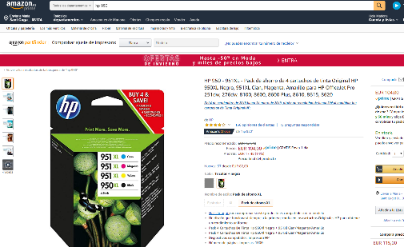

ASIN-based assets lead to DE designs showing up in ES Amazon pages
https://www.amazon.es/HP-950-951XL-cartuchos-Original-OfficeJet/dp/B00D145OYY/ref=sr_1_3?ie=UTF8&qid=1546957297&sr=8-3&keywords=hp+950
Notes:
Same ASIN, different content:
https://www.amazon.fr/HP-Cartouches-Capacit%C3%A9-Authentiques-N9J74AE/dp/B01ARRTHPO/ref=sr_1_1?ie=UTF8&qid=1548257844&sr=8-1&keywords=B01ARRTHPO
https://www.amazon.de/HP-Multipack-Druckerpatronen-Reichweite-Photosmart/dp/B01ARRTHPO/ref=sr_1_1?ie=UTF8&qid=1548257833&sr=8-1&keywords=B01ARRTHPO
https://www.amazon.es/HP-364XL-cartuchos-capacidad-PhotoSmart/dp/B01ARRTHPO/ref=sr_1_3?ie=UTF8&qid=1548257815&sr=8-3&keywords=hp+364

Slide 10



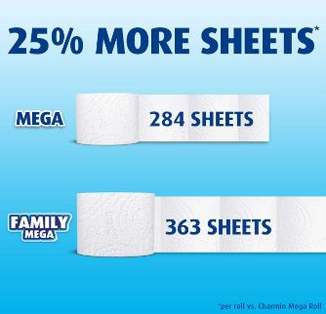

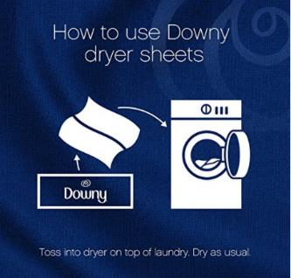
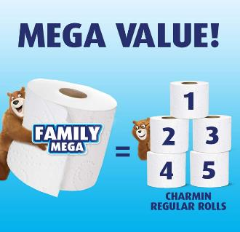


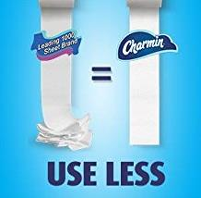


What are others doing in the Amazon space

Slide 11
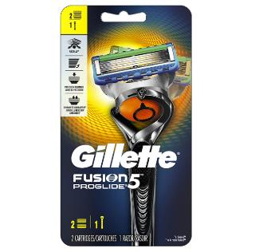
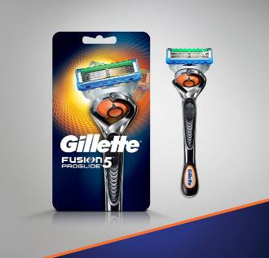
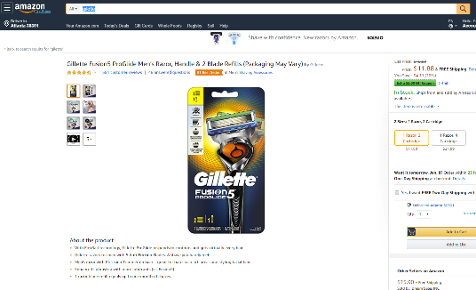
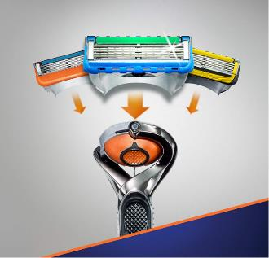
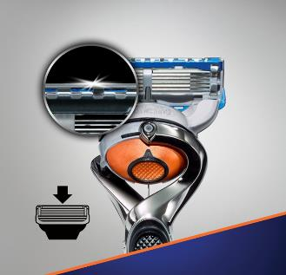

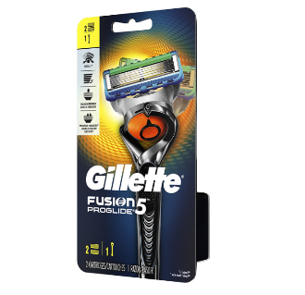
https://www.amazon.com/Gillette-Fusion5-ProGlide-Refills-Packaging/dp/B06X9PM3GJ/ref=sr_1_5_a_it?ie=UTF8&qid=1546874005&sr=8-5&keywords=gilette&th=1
No copy
Simple
Usage of understandable icons
No logo
Brand consistency
What’s in the box

Slide 12


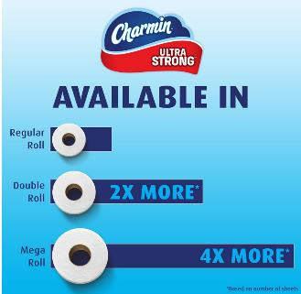
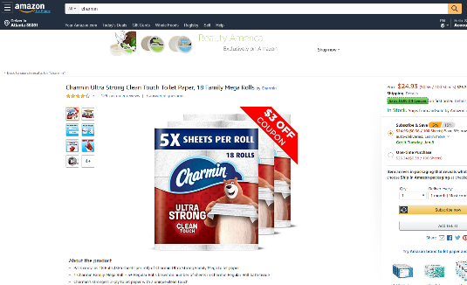
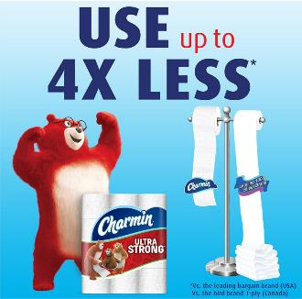
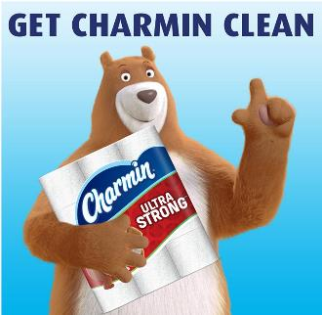


https://www.amazon.com/Charmin-Strong-Toilet-Family-Packaging/dp/B0798DVT69/ref=sr_1_8_a_it?ie=UTF8&qid=1546875089&sr=8-8&keywords=charmin
Short and value messages
Clear and large copy
Simple
No logo
Brand consistency
What’s in the box
Inspiration for sustainability designs:

Slide 13
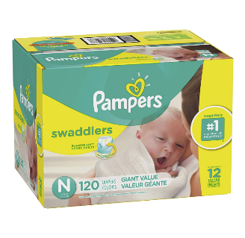

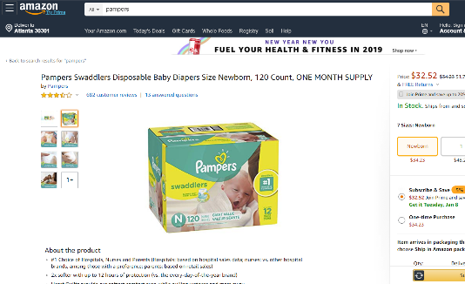


https://www.amazon.com/Pampers-Swaddlers-Disposable-Diapers-120/dp/B07DCB7H79/ref=sr_1_3_a_it?ie=UTF8&qid=1546876179&sr=8-3&keywords=pampers&th=1
Short and clear messages
Value images
No logo
Brand consistency
Copyrighted images
Emotional connection

Slide 14
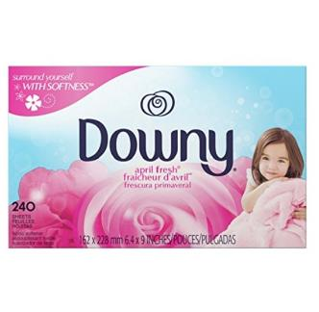
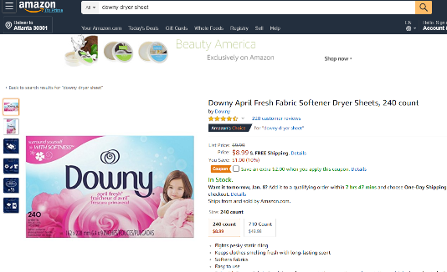

https://www.amazon.com/Downy-April-Fabric-Softener-Sheets/dp/B01ABVJWK6/ref=sr_1_3_a_it?ie=UTF8&qid=1546877430&sr=8-3&keywords=downy+dryer+sheet
Short and large copy
Clear value
No logo
Brand consistency
Usage of understandable icons

Slide 15
Fighting against remans’ infographics

Slide 16




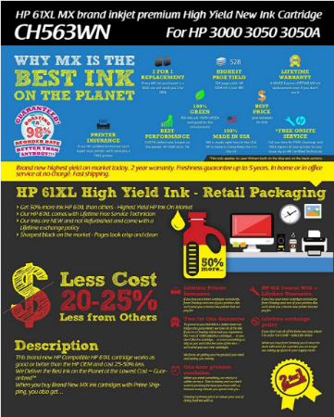

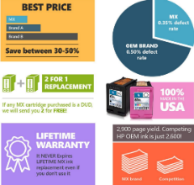
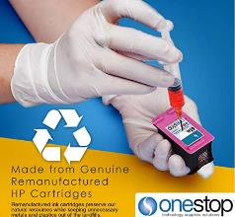
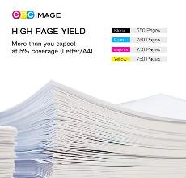
Refillers / Remans use
encroaching visuals and compelling messaging
https://www.amazon.com/MX-Brand-Inkjet-Premium-Cartridge/dp/B017L6FPZ0/ref=sr_1_8?s=office-products&ie=UTF8&qid=1481653951&sr=1-8&keywords=hp+61

Slide 17
Asset specifics – technical requirements
Minimum 6 images / Minimum 2 HD images
The minimum requirements for Amazon can be found here, so absolutely everything must adhere to this at the very least if nothing else - https://www.amazon.com/gp/help/customer/display.html?nodeId=200109520
Recommended requirements for Amazon can vary depending on the source that you take it from, but I usually work with this in mind
    Images should be 2000 x 2000 pixels in size or more – at the very least greater than 1000 pixels in height and width which is the lowest that I’ve seen recommended anywhere. Really it should be as high pixel density as possible though
    The picture of the product needs to fill 85% of the image
    There should be a margin of 10 pixels on all 4 sides of the image at least (but not much greater than that if at all – otherwise it will be hard to fulfil the previous point)
    The file format should be .jpeg (even if other formats are accepted).
Ensure it is optimized for 5 inch devices – mobile optimized.
I believe that all files should be under 10mb in size so really they should have as high pixel density as possible while still fitting under this. Compressing images is often advised so this is fine to do as long as it does not impact image quality noticeably.

Slide 18
Some concepts and ideas…

Slide 19
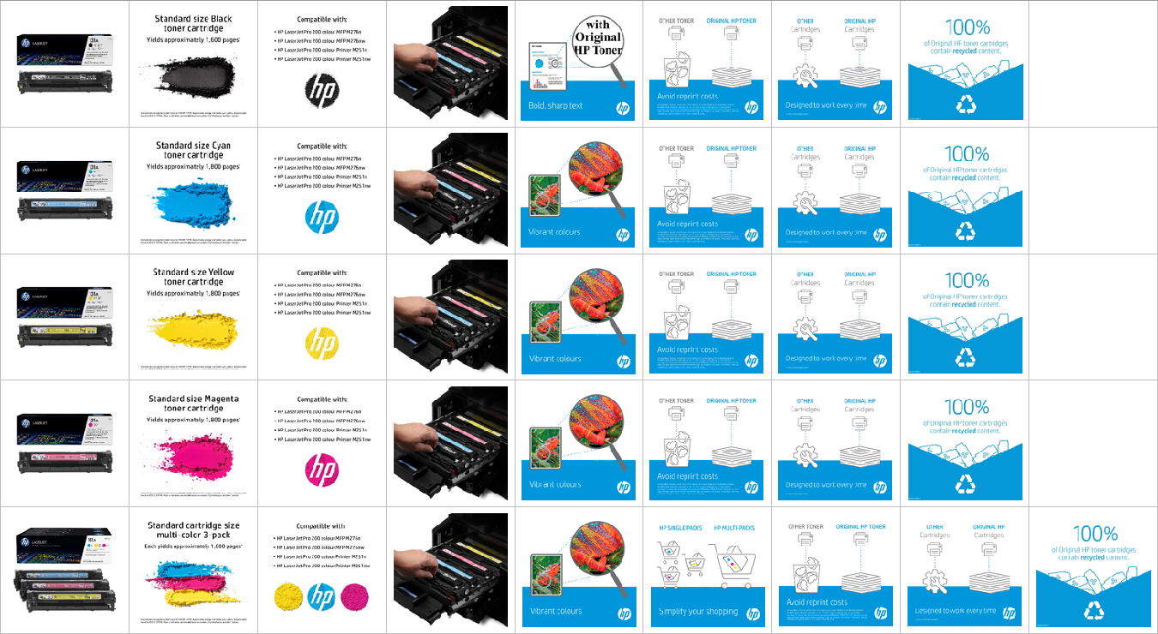

Slide 20
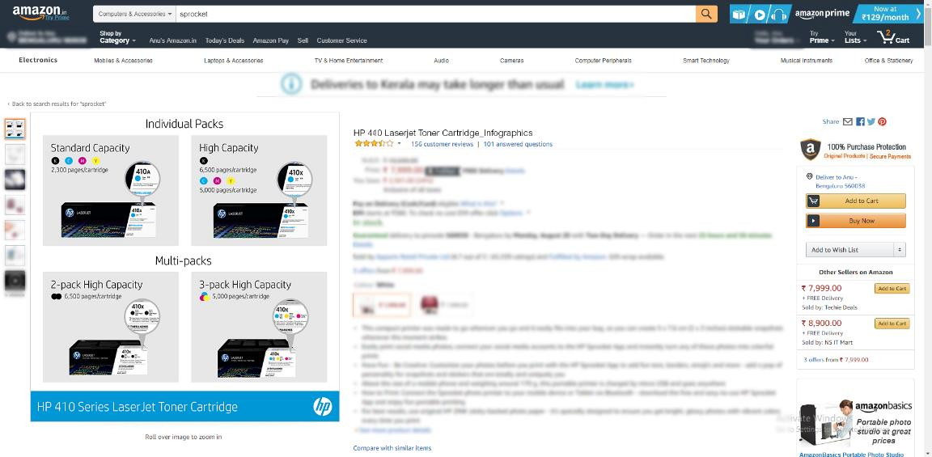

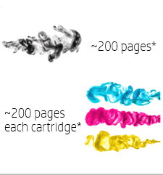













Slide 21



Slide 22


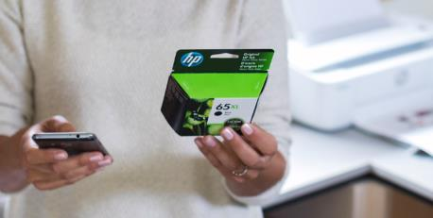
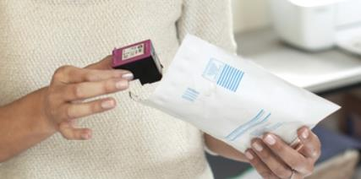
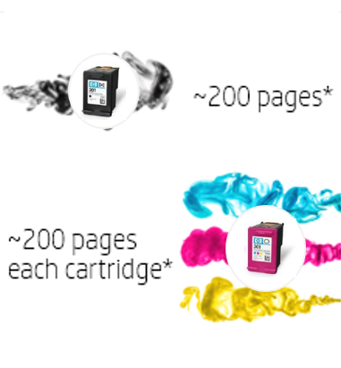
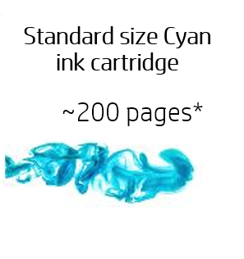
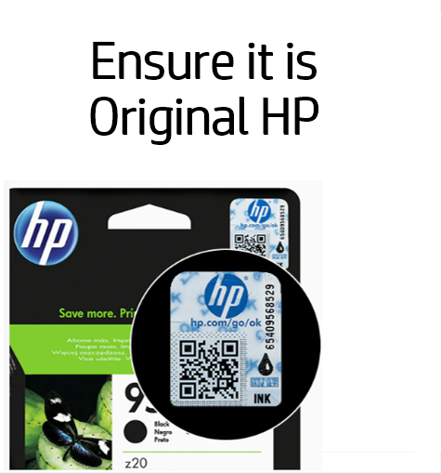
“We ensure that what you’ll get is OHP” - reassurance
Motivations/personal message like “Recycle today for a better tomorrow with HP”.
“do the right thing”.
Ensure it is Original HP
Easy and free recycling

Slide 23


Page yield
~165 pages

Slide 24
Page yield
~165 pages

Slide 25

Page yield
~165 pages

Slide 26


Standard size
~1300 pages

Slide 27


Page yield
~165

Slide 28
Page yield
~165/cartridge

Slide 29







Slide 30







